Slide 1
Local Search (3): Evaluation and Analysis
Shaowei Cai, UCAS, 2020

Slide 2
Experiments
Good experiments
Reproducible: performs the same experiment should get similar results.
Efficient: produces correct results without wasting time and resources.
Generality: the conclusions drawn from one experiment apply broadly rather than narrowly
Newsworthiness: interesting and useful to the research community, and therefore publishable.

Slide 3
The Pilot and the Workhorse
Experiments have two flavors:
the less formal pilot or exploratory study,
The more carefully designed workhorse study.
The pilot study may be motivated by fuzzy questions
Which data structure is better?
Which input parameters appear to be relevant to performance?
The workhorse study comprises experiments built upon precisely stated problems
the mean comparison costs for data structures A and B, on instances drawn randomly from input class C;
How the solution quality increases with the run time?

Slide 4
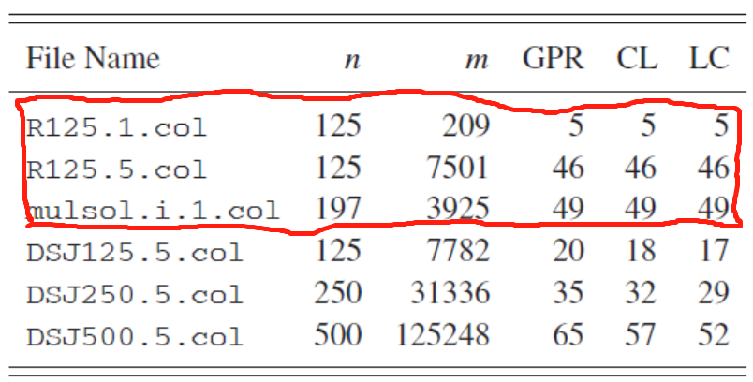
Road to errors in experiments
Start it correctly, avoid typical errors in experiment setup
Benchmarks: Ceiling and floor effects
Too hard or too easy to distinguish the algorithmic ideas being compared.
experimental artifacts
Bugs in test programs produce wrong answers.
Pseudorandom number generators
Floating point precision errors can creep into any calculation

Slide 5
Experimental Design Basics
Performance metric (e.g. time, solution quality …)
Performance indicator (CPU time, size, …)
Parameters
Algorithm parameters
Instance parameters
Environment parameters (compiler, OS, and platform)
Factor: A parameter explicitly manipulated in experiment.
Level: A value assigned to a factor in an experiment.
E.g. n = (100, 200,300), m = (sparse, dense).
Design point: A particular combination of levels to be tested.
Trial or test: One run of the test program at a specific design point
Fixed parameter: A parameter held constant through all trials.
Noise parameter: A parameter with levels that change from trial to trial in some uncontrolled or semicontrolled way.

Slide 6
Selecting Input Classes
Stress-test inputs: invoke bugs and reveal artifacts by invoking boundary conditions
Empty graph, complete graph, rings, trees,…
bad-case instances are hard (or expensive) for particular algorithms to solve.
Greedy coloring algorithms exhibits especially poor performance on crown graphs
Random inputs
Structured random inputs
Real instances
Hybrid instances combine real-world structures with generated components
Public testbed
The choice of instance classes to test should reflect general experimental goals as well as the specific question at hand.

Slide 7
Choosing Factors and Design Points
Motivating questions
Assessment
Solution distribution; what input properties that have most impact
horse race
Fitting functions
Modeling
finding the correct function family to describe a given cost

Slide 8
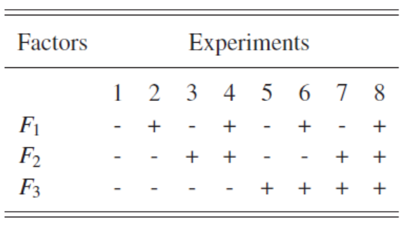
Factorial Designs
A common goal of algorithm research is to compare performance across several algorithm and instance factors, to discover which ideas work for which inputs.
full factorial design: to study main effects and interaction effects among factors.
Latin hypercube design: when the design space is huge, we usually use space filling design on the space.

Slide 9
Data Analysis
The premise underlying any report of experimental results is, If you perform the same experiment, your outcomes will be similar to mine.
my experiment and your experiment both draw a random data sample from the same underlying probability distribution.
one sample may be different from those of the next, but they have some features in common because they are from the same source
Data analysis is applied to describe, quantify, and sometimes explain those common features.

Slide 10
Categories of Data
Categorical data are qualitative rather than quantitative.
Ordinal data can be ranked (first, second, third) but have no scale
Interval data
Ratio data
Counts and amounts
Differences

Slide 11
Categories of Data Analysis
Descriptive statistics: providing concise descriptions of the essential properties of a data sample.
Exploratory data analysis: discovering patterns and relationships in the data.
Graphical data analysis emphasizes the use of graphs and visualization techniques to understand the sample.
inferential statistics

Slide 12
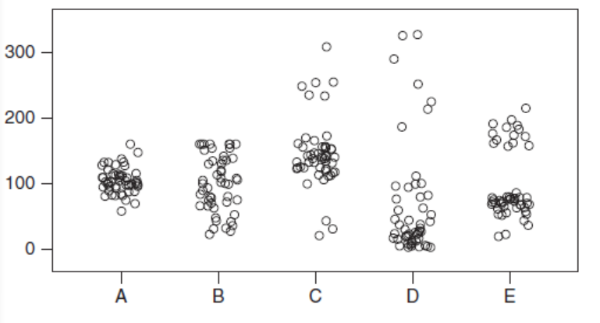
Descriptive Statistics
Descriptive statistics is concerned with finding concise summaries of key properties of data samples
the location, or central tendency of the data.
dispersion, or how much spread there is away from the center
Location and dispersion are the yin and yang of data summaries; do not report one without the other.

Slide 13
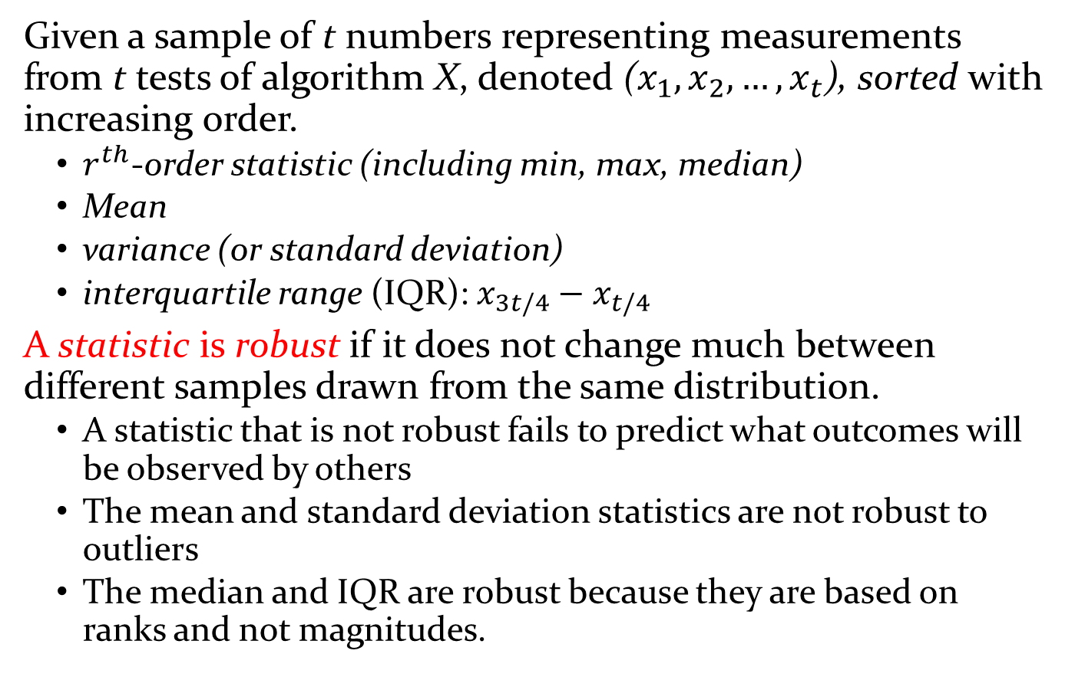
Descriptive Statistics --- Common Summary Statistics
Given a sample of t numbers representing measurements from t tests of algorithm X, denoted ($x_{1},x_{2},…,x_{t}$), sorted with increasing order.
$r^{th}$-order statistic (including min, max, median)
Mean
variance (or standard deviation)
interquartile range (IQR): $x_{3t/4}−x_{t/4}$
A statistic is robust if it does not change much between different samples drawn from the same distribution.
A statistic that is not robust fails to predict what outcomes will be observed by others
The mean and standard deviation statistics are not robust to outliers
The median and IQR are robust because they are based on ranks and not magnitudes.

Slide 14
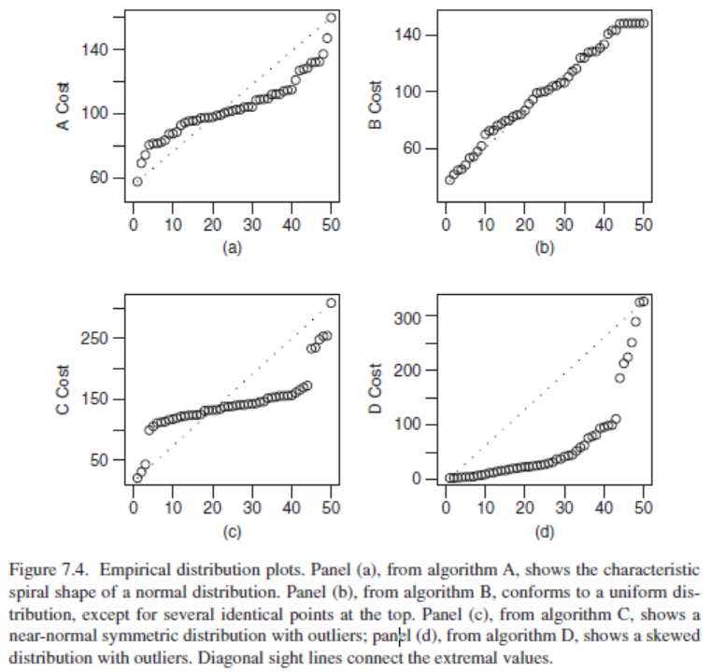
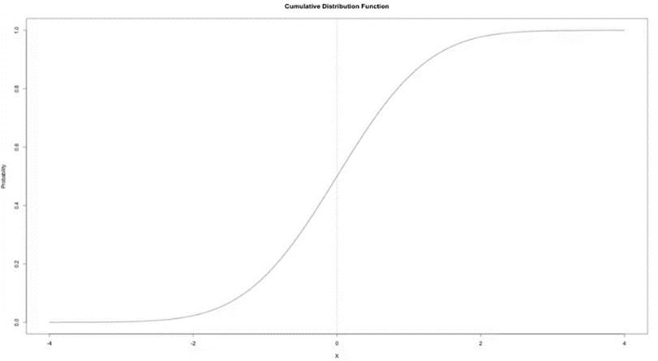
Descriptive Statistics --- Kurtosis
Kurtosis
CDF of a normal distribution
(a) Shows normal distribution, but with x and y axes reversed

Slide 15
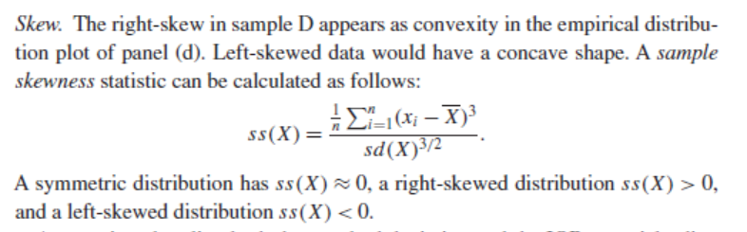
Descriptive Statistics --- Skewness
the standard deviation and the IQR are misleading statistics of dispersion for skewed data because “dispersion” is normally understood as being the same on both sides of the center.

Slide 16
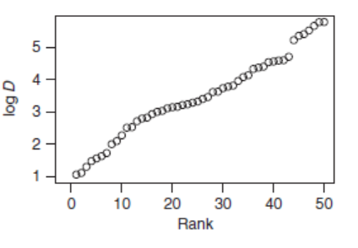
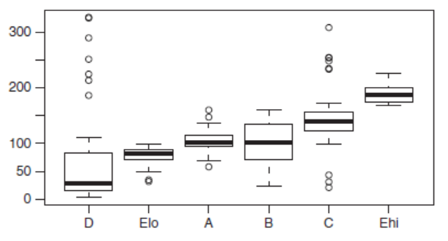

Descriptive Statistics --- Statics for skewed data
Statistics for skewed data sets
summarize dispersion separately on each side.
report the hinges of the data set ($x_{1}, {x_{t/4},x_{t/2},x}_{3t/4},x_{t}$)
data transformation: apply logarithmic transformation, or more generally a power transformation, to impose symmetry in a skewed data sample
Boxplot summaries of the hinges of samples A through E (E is split into two groups).)
An empirical density plot of data set D after logarithmic transformation.

Slide 17
Descriptive Statistics --- Making Inferences
Hypothesis testing: which answers yes-or-no questions about the model. Use statistical significance to quantify the likelihood that the result of a hypothesis test is due to random chance rather than an intrinsic property of the model.
Parameter estimation: finding good estimates of parameters such as μ and σ, together with confidence intervals that bound the accuracy of those estimates.

Slide 18
Features of Stochastic Local Search
stochastic local search
No guarantee that an (optimal) solution will eventually be found.
However, in the case of a decision problem, if a solution is returned, it is guaranteed to be correct.
The time required for finding a solution (in case a solution is found) is a random variable.

Slide 19
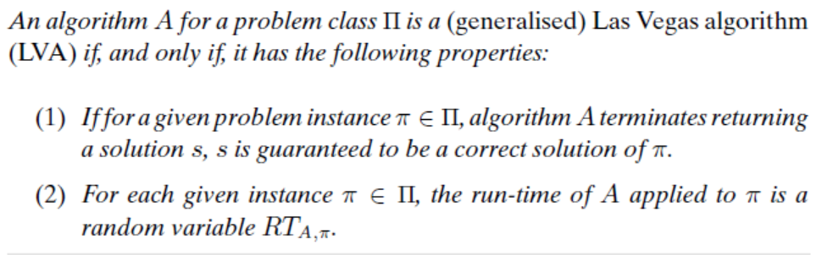
Las Vegas Algorithm
In TCS, usually two (equivalent) definitions of Las Vegas algorithms are used. Both of these definitions assume that the algorithm terminates in finite time; they mainly differ in that the first definition requires the algorithm to return a solution, while the second definition requires that the probability of returning a correct solution is larger or equal than 0.5.
Any SLS algorithm for a decision problem is a Las Vegas algorithm.

Slide 20
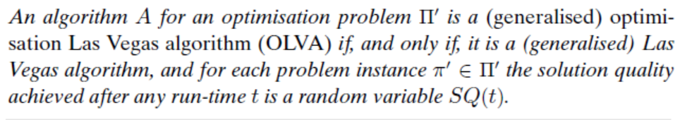
Optimization Las Vegas Algorithm
the solution quality achieved within a bounded run-time is a random variable;
the run-time required for achieving or exceeding a given solution quality is a random variable.

Slide 21
Las Vegas and Monte Carlo
Las Vegas algorithms can be seen as a special case of the larger class of Monte Carlo Algorithms.
Monte Carlo algorithms are randomised algorithms with randomly distributed run-times.
a Monte Carlo algorithm can sometimes return an incorrect answer
while for Las Vegas algorithms, only false negatives (missed correct solutions) are allowed.

Slide 22
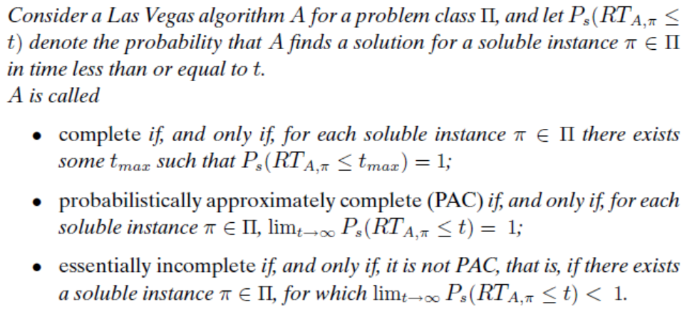
The Completeness of Las Vegas Algorithms

Slide 23

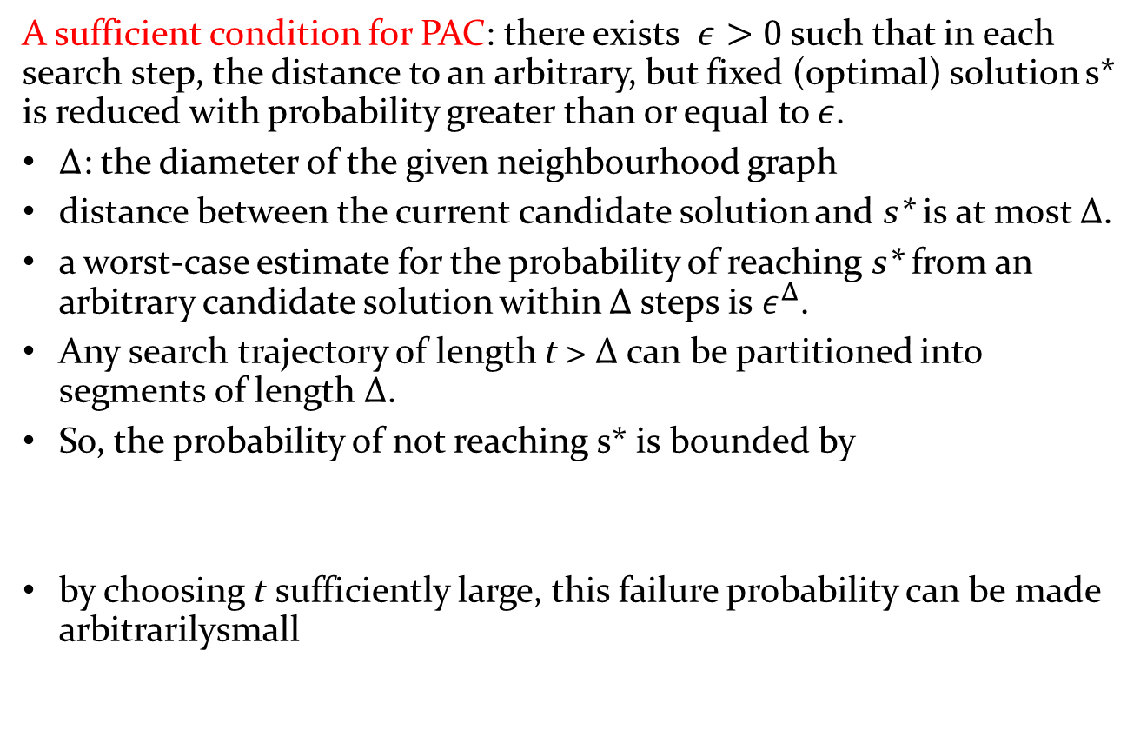
PAC
A sufficient condition for PAC: there exists $ε>0$ such that in each search step, the distance to an arbitrary, but fixed (optimal) solution s* is reduced with probability greater than or equal to $ε$.
Δ: the diameter of the given neighbourhood graph
distance between the current candidate solution and s* is at most Δ.
a worst-case estimate for the probability of reaching s* from an arbitrary candidate solution within Δ steps is $ε^{Δ}$.
Any search trajectory of length t > Δ can be partitioned into segments of length Δ.
So, the probability of not reaching s* is bounded by
by choosing t sufficiently large, this failure probability can be made arbitrarilysmall

Slide 24
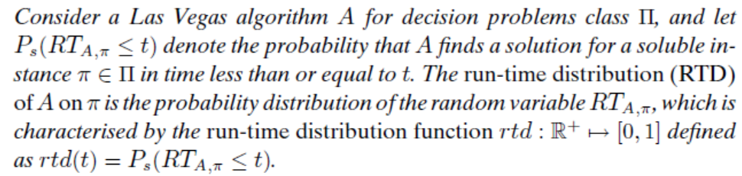
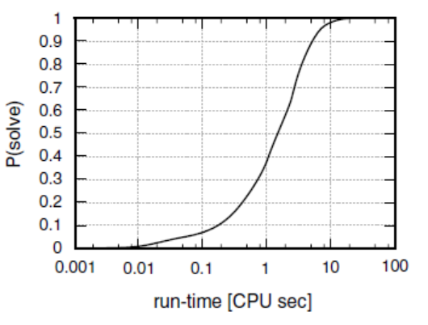
Run-Time Distributions
Need to perform many runs (such as 1000) of an algorithm on an instance, and use the success frequency to estimate the success probability.

Slide 25
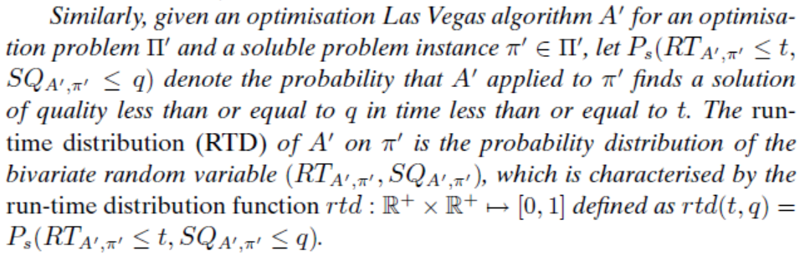
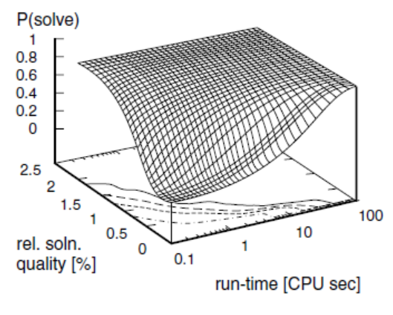

Slide 26
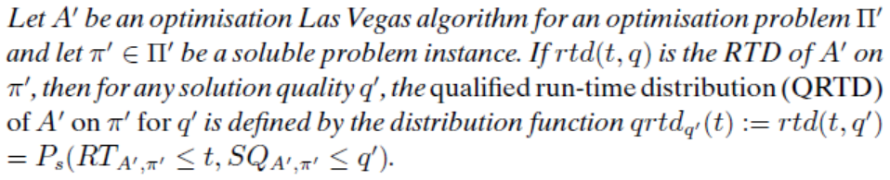
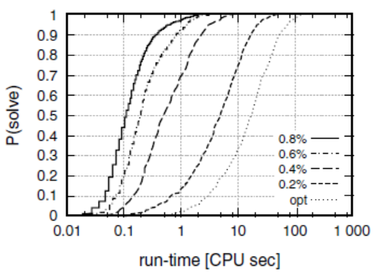
Qualified Run-Time Distribution

Slide 27
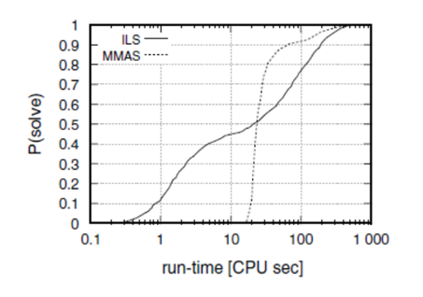
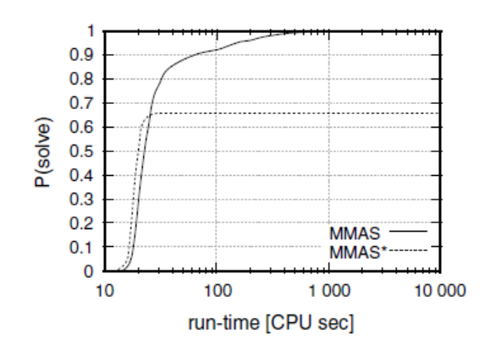
Comparing Algorithms Based on RTDs
Comparison with various time limit
PAC or essential incomplete

Slide 28
Functional Approximation of Empirical RTDs
For empirical RTDs, approximations with parameterised families of continuous probability functions known from statistics, such as exponential or normal distributions, are particularly useful.
Given an empirical RTD and a parameterised family of cumulative probability functions
good approximations can be found using standard model fitting techniques,
the Marquart-Levenberg algorithm
expectation maximisation (EM) algorithm
The quality of the approximation can be assessed using standard statistical goodness-of-fit tests

Slide 29
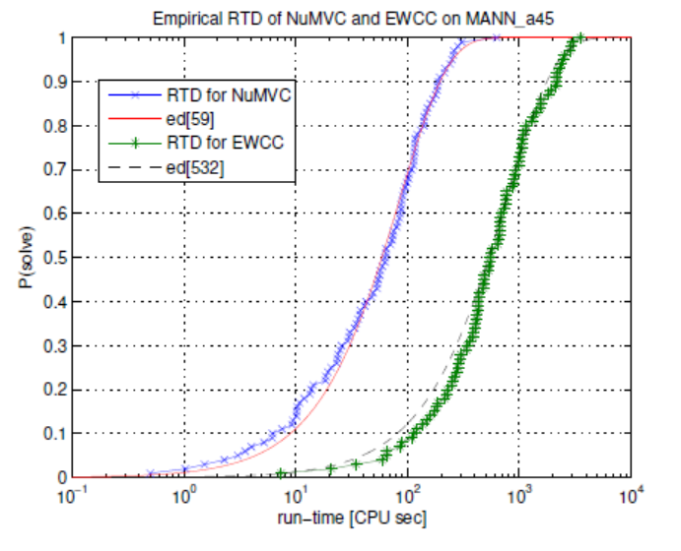

Exponential Distribution
The probability density function is f(x) = me^{–mx} with m>0.
The cumulative distribution function (CDF) is
$\int_{0}^{x}{me^{−mx}dx}={−e^{−mx}|}_{0}^{x}=1−e^{−mx}$
Memorylessness of the Exponential Distribution
P (X > r + t | X > r) = P (X > t) for all r ≥ 0 and t ≥ 0

Slide 30
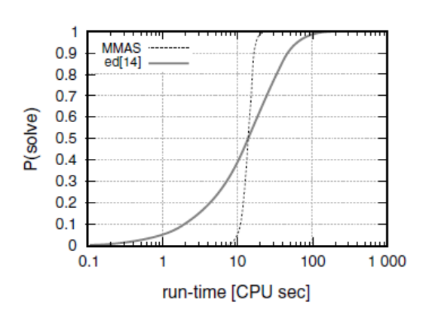
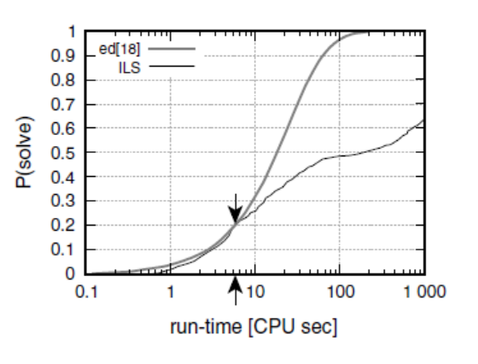
Optimal Restarting Times
An algorithm’s RTDs, when compared with exponential distribution, can often suggest ways of improving the performance of the algorithm.
RTD is consistently steeper than an exponential indicates that restart with any fixed cutoff time will lead to performance loss
Find the optimal static restarting time

Slide 31
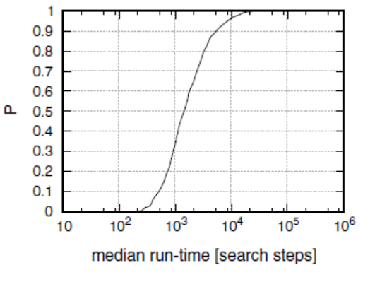
Search Cost Distribution
RTD is about the performance of an algorithm on an instance, but if we want to investigate the performance of an algorithm on an ensemble of instances, we would study Search Cost Distribution, or called Hardness Distribution w.r.t. the algorithm on the benchmark.
Distribution of median local search cost for the same algorithm across a set of
1000 Random 3-SAT instances.

Slide 32
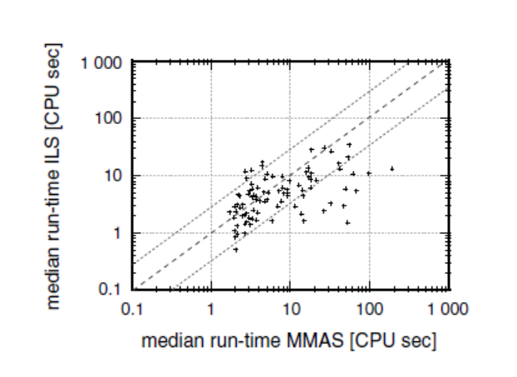
Comparative Analysis on Instance Ensembles
Correlation between median run-time required by MMAS vs ILS for finding
the optimal solutions to instances of a set comprising 100 TSP instances with 300 vertices each; each median was measured from 10 runs per algorithm.

Slide 33
Theoretical Analysis for Local Search
See lecture notes.

